Slide 1
PROG102 PRINCIPLES OF SOFTWARE ENGINEERING
LECTURE 4: SYSTEM MODELING WITH UML AND SOFTWARE DESIGN PRINCIPLES
ALL RIGHTS RESERVED
No part of this document may be reproduced without written approval from Limkokwing University of Creative Technology

Slide 2
Learning Objectives:
Overview of UML (Unified Modeling Language)
Class Diagrams, Sequence Diagrams, Activity Diagrams
Software Design Patterns
Creating Class and Sequence Diagrams
Designing Software Architecture Using UML
ALL RIGHTS RESERVED
No part of this document may be reproduced without written approval from Limkokwing University of Creative Technology

Slide 3
Unified Modeling Language:
Unified Modeling Language (UML) is a standardized general-purpose modeling language used in software engineering to visualize, design, and document software systems. It provides a set of graphical notation techniques to create abstract models of systems, making it easier to understand, discuss, and improve software design. UML is not a programming language, but it helps in planning and visualizing software before coding.

Slide 4
Purpose and Uses of UML:
Helps in software design & architecture.
Improves communication among stakeholders.
Supports documentation for future maintenance.
Enables model-driven development (MDD).
Common Uses
Software development (OOP)
Business process modeling
System design & documentation

Slide 5
Types of UML Diagrams:
Structural Diagrams (static structure):
Class Diagram
Object Diagram
Component Diagram
Deployment Diagram
Package Diagram
Composite Structure Diagram
Behavioral Diagrams (dynamic behavior):
Use Case Diagram
Activity Diagram
State Machine Diagram
Interaction Diagrams:
Sequence Diagram
Communication Diagram (formerly Collaboration Diagram)
Timing Diagram
Interaction Overview Diagram

Slide 6
Structural UML Diagrams (Focus on Static System Structure)
1. A Class Diagram is a structural UML diagram that represents the static structure of a system by showing:
Classes (blueprints for objects),
Attributes (data/properties),
Methods (functions/behaviors),
Relationships between classes (e.g., inheritance, association).
Key Components of a Class Diagram
Class
Represents an object type (e.g., Car, Student, BankAccount).
Divided into 3 compartments:
Class Name (e.g., User).
Attributes (e.g., username, password).
Methods (e.g., login(), logout()).

Slide 7
Cont…
2. Attributes & Methods
Attributes: Variables/properties (e.g., -age: int).
- = private, + = public, # = protected.
Methods: Functions (e.g., +calculateTotal(): double).
3. Relationships
Type Notation Example
Association ─── Student ─── attends ─── Course
Inheritance ◄─── (triangle) Car ◄─── ElectricCar
Aggregation ◇─── (hollow) Department ◇─── Employee (weak)
Composition ◆─── (filled) Car ◆─── Engine (strong)
Dependency ⤹─── (dashed) Order ⤹─── Payment (temporary)

Slide 8
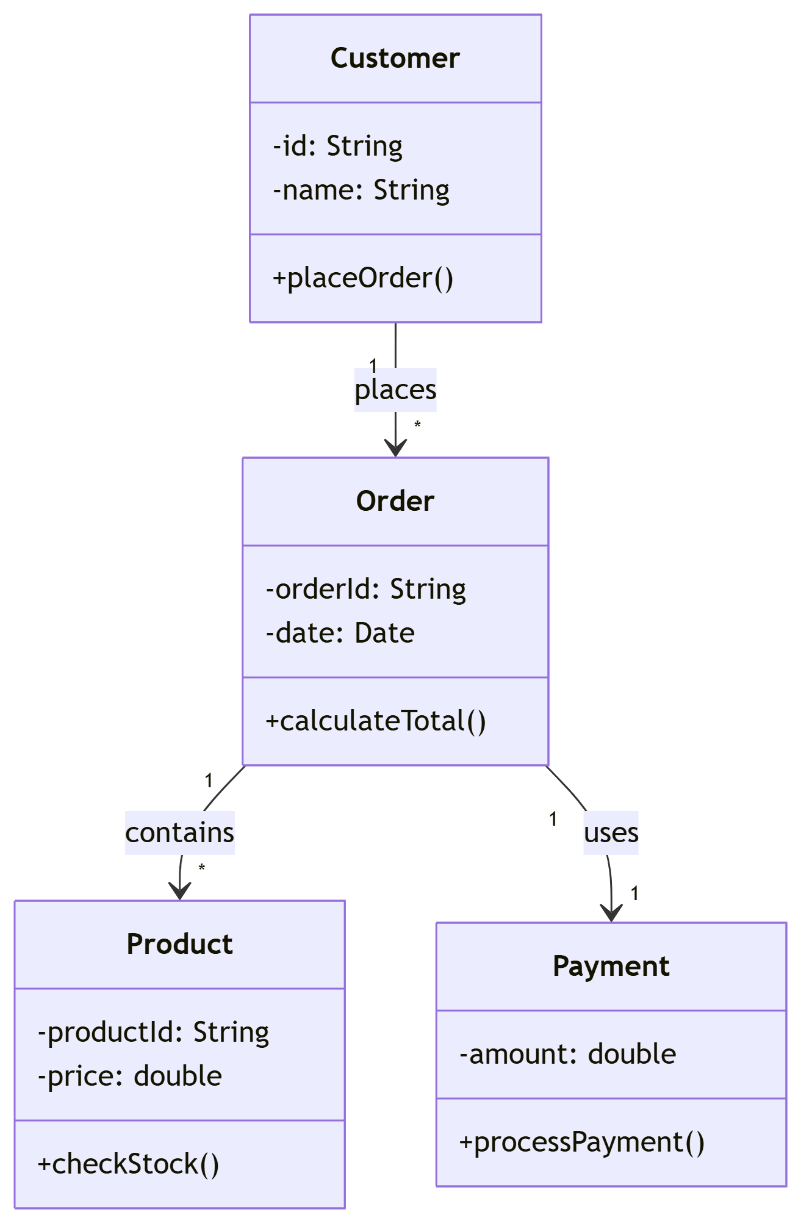
Real-World Example: E-Commerce System:
Diagram
CODE
classDiagram
class Customer {
-id: String
-name: String
+placeOrder()
}
class Order {
-orderId: String
-date: Date
+calculateTotal()
}
class Product {
-productId: String
-price: double
+checkStock()
}
class Payment {
-amount: double
+processPayment()
}
Customer "1" --> "*" Order : places
Order "1" --> "*" Product : contains
Order "1" --> "1" Payment : uses
Explanation:
A Customer can place multiple Orders.
An Order contains multiple Products.
Each Order uses one Payment.

Slide 9
Object Diagram: Definition:
An Object Diagram is a structural UML diagram that shows a snapshot of objects (instances of classes) and their relationships at a specific moment in time. It provides a concrete view of a system’s runtime state, unlike a Class Diagram, which is abstract.
Key Components of an Object Diagram
Objects (Instances)
Represent real-world entities created from classes.
Notation: objectName : ClassName (e.g., john : Customer).
Attributes are shown with current values (e.g., name = "John Doe").
Links (Relationships)
Show how objects interact or depend on each other.
Notation: A solid line connecting objects (e.g., john ──► order123).

Slide 10
Component Diagram Definition:
A component diagram in the Unified Modeling Language (UML) is a type of structure diagram that illustrates the organization and relationships among the components in a system. Think of components as modular, deployable units of your software. Component-based diagrams are essential tools in software engineering, providing a visual representation of a system’s structure by showcasing its various components and their interactions. These diagrams simplify complex systems, making it easier for developers to design, understand, and communicate the architecture.It shows:
Components (self-contained, reusable modules like libraries, APIs, or services),
Interfaces (how components communicate),
Dependencies between components.

Slide 11
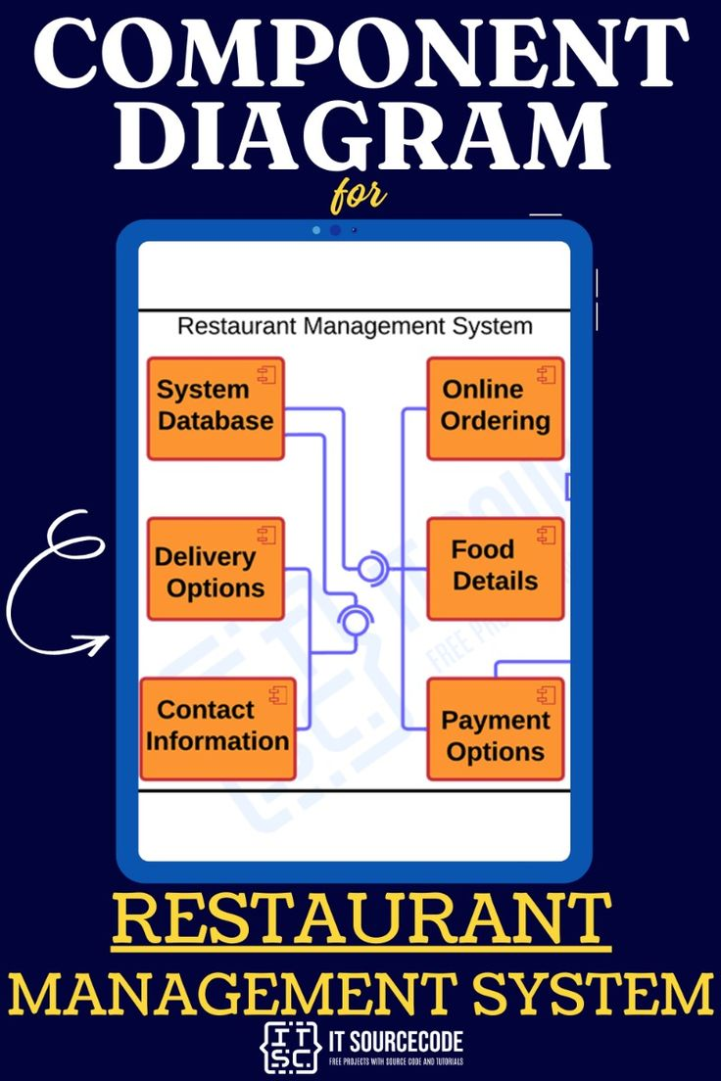
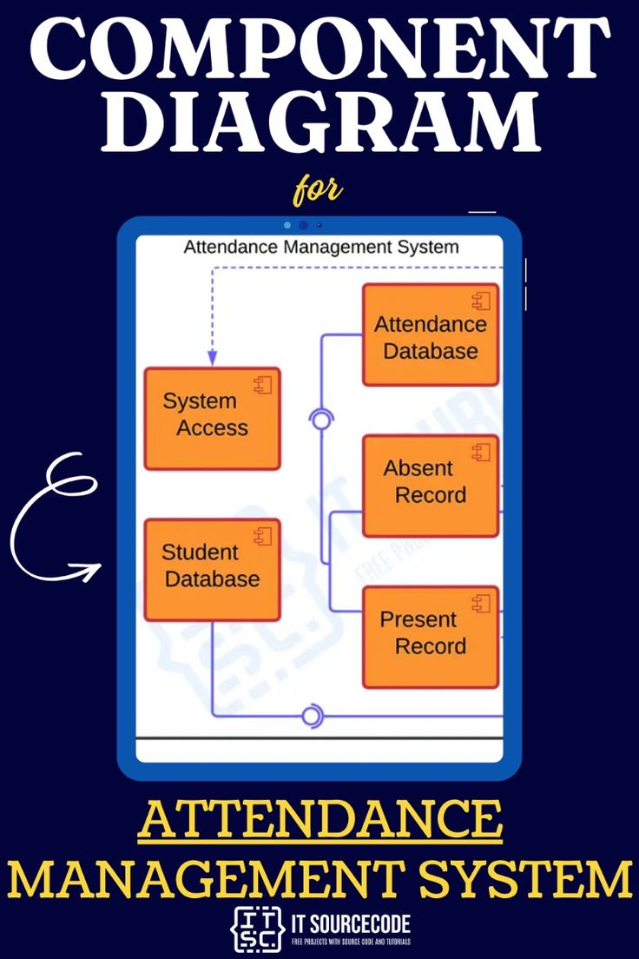
Component Diagrams:

Slide 12
Deployment Diagram:
A deployment diagram in the Unified Modeling Language (UML) is a type of structure diagram that visualizes the physical deployment of the artifacts (software components, executables, data files, etc.) onto the hardware nodes (servers, devices, etc.) in a system. Think of it as a map showing where your software lives and runs.

Slide 13
Key components:
1. Node
Represents hardware (e.g., servers, routers, IoT devices).
Types:
Device (physical machine, e.g., Mobile Phone, Cloud Server).
Execution Environment (software container, e.g., Docker, JVM).
2. Artifact
Software deployed on nodes (e.g., web-app.war, database.dll).
3. Association
Connects artifacts to nodes (shows deployment).

Slide 14
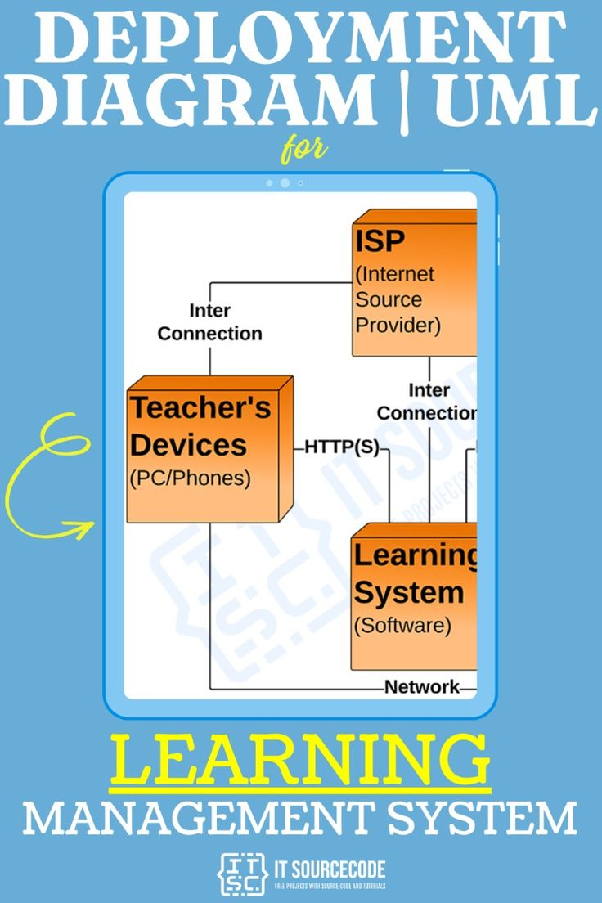
Deployment Diagram:
It answers:
Where does the system run?
How are artifacts distributed across machines?

Slide 15
Package Diagram
A package diagram in the Unified Modeling Language (UML) is a type of structure diagram that is used to organize the elements of a model into logical groups called packages. Think of packages as folders or namespaces that help you manage complexity in large systems. Organizing Model Elements: It provides a way to structure a complex UML model by grouping related elements (like classes, use cases, components, and even other diagrams) together.

Slide 16
Composite Structure Diagram
A composite structure diagram in UML is a type of structure diagram that allows you to deconstruct a classifier (like a class, component, or deployment node) and model its internal structure. It shows how the classifier is composed of parts, how these parts are connected, and how they interact within the context of the containing classifier.Think of it as opening up a "black box" (the classifier) and revealing its inner workings and connections.

Slide 17
Behavioral Diagrams (dynamic behavior): Use Case Diagram
A Use Case Diagram in Unified Modeling Language (UML) is a behavioral diagram that captures the functional requirements of a system. It illustrates how different actors (users, external systems, or other entities) interact with the system to achieve specific goals. Use Case Diagrams are widely used during the requirements gathering and analysis phases of software development to understand the scope of the system and its high-level functionality.

Slide 18
Key Elements of a Use Case Diagram
1. Actors :
Represent entities that interact with the system.
Can be humans (e.g., users), external systems, or devices.
Symbolized by a stick figure.
2. Use Cases :
Represent specific functionalities or actions provided by the system.
Encapsulated in an oval shape with a brief description inside.

Slide 19
Key Elements of a Use Case Diagram
3. System Boundary :
A rectangle representing the boundary of the system.
Use cases are placed inside the rectangle, while actors are outside.
Relationships :
Association : A line connecting an actor to a use case, indicating interaction.
Include : A dashed arrow labeled "<<include>>" showing that one use case always includes another.
Extend : A dashed arrow labeled "<<extend>>" showing that one use case conditionally adds behavior to another.
Generalization : A solid arrow with a triangular head indicating inheritance between actors or use cases.

Slide 20
Visual Representation
Below is a textual description of how the diagram would look:
1. Draw a rectangle to represent the System Boundary labeled "Online Shopping System."
2. Place the following Use Cases inside the rectangle:
Browse Products
Add to Cart
Checkout
Make Payment
Manage Inventory
Process Refund
3. Place the following Actors outside the rectangle:
Customer
Admin
Payment Gateway
4. Connect actors to use cases with association lines:
Customer → Browse Products
Customer → Add to Cart
Customer → Checkout
Customer → Make Payment
Admin → Manage Inventory
Admin → Process Refund

Slide 21
Key Elements of a Use Case Diagram
5. Add relationships:
Draw a dashed arrow from "Checkout" to "Make Payment" labeled "<<include>>."
Draw a dashed arrow from "Process Refund" to "Manage Inventory" labeled "<<extend>>."
6. Connect the Payment Gateway actor to the "Make Payment" use case.

Slide 22
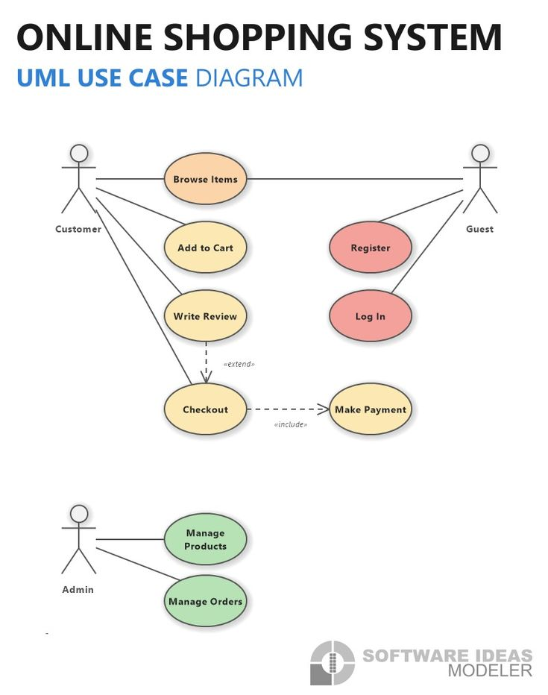
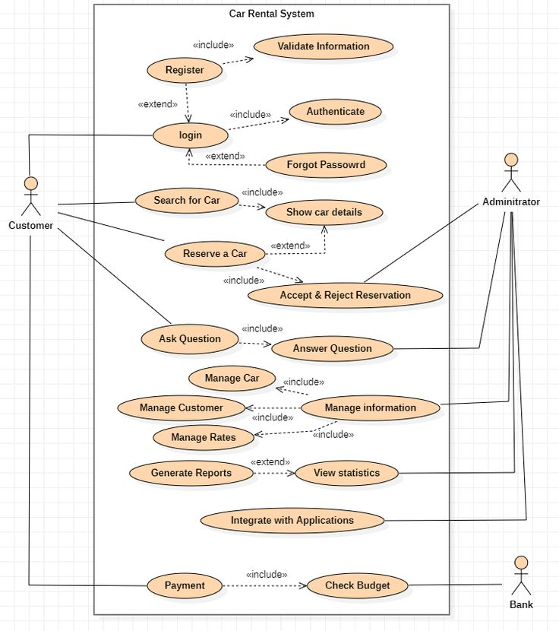
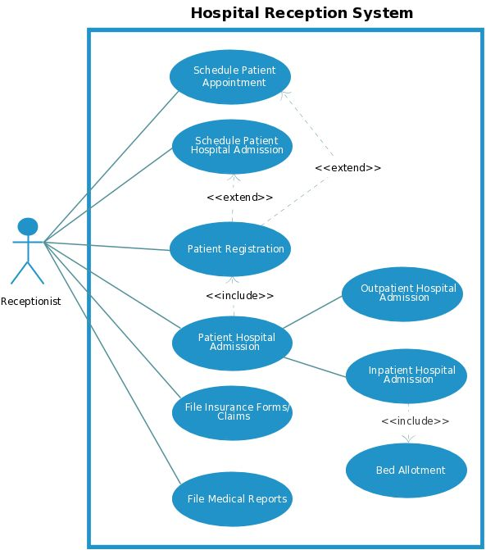
Use Case Diagrams of Online shopping system Car rental system and Hospital Reception syst.

Slide 23
Activity Diagram
An Activity Diagram in Unified Modeling Language (UML) is a behavioral diagram that represents the flow of activities within a system. It is used to model the dynamic aspects of a system, such as workflows, business processes, or operational sequences. Activity diagrams are particularly useful for understanding how different tasks or actions are performed in a sequence and how decisions affect the flow of control.
Activity diagrams are similar to flowcharts but are more powerful because they can model parallel processes, decision points, and complex interactions.

Slide 24
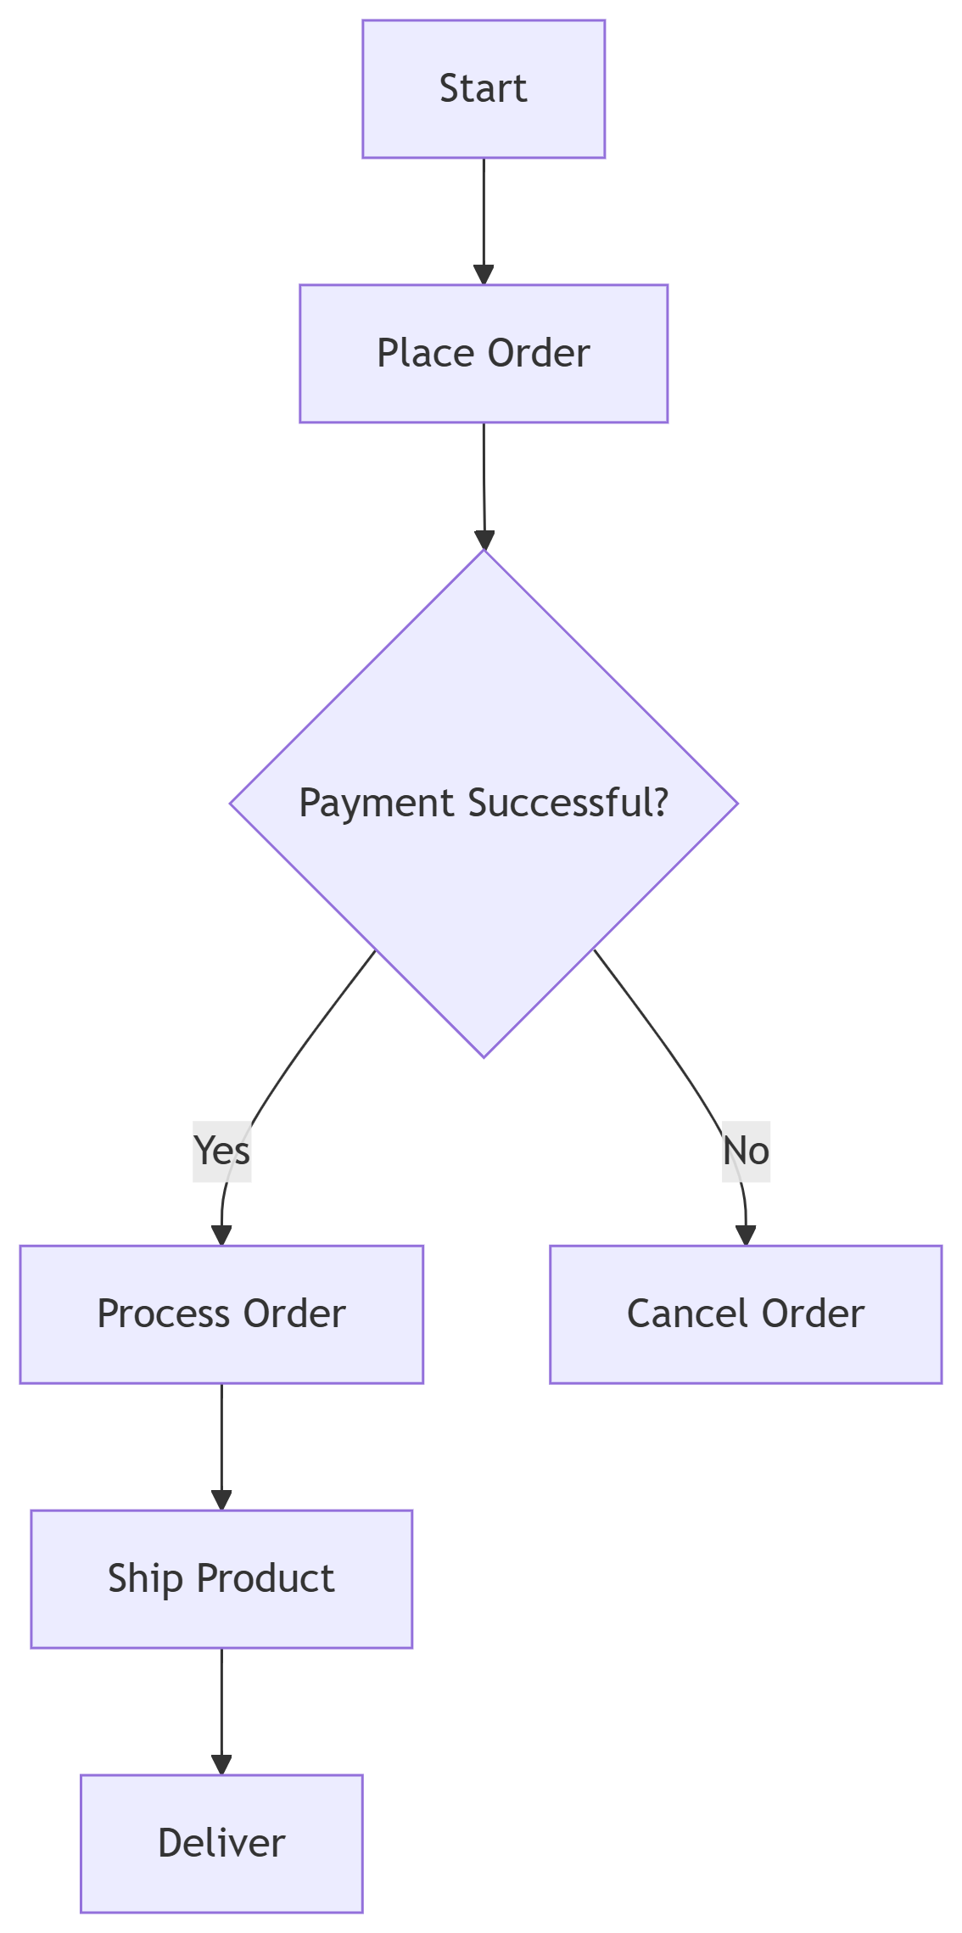
Activity Diagram
Key Elements:
Actions (rounded rectangles)
Decisions (diamonds)
Example:
Order Processing Flow from "Place Order" to "Delivery".

Slide 25


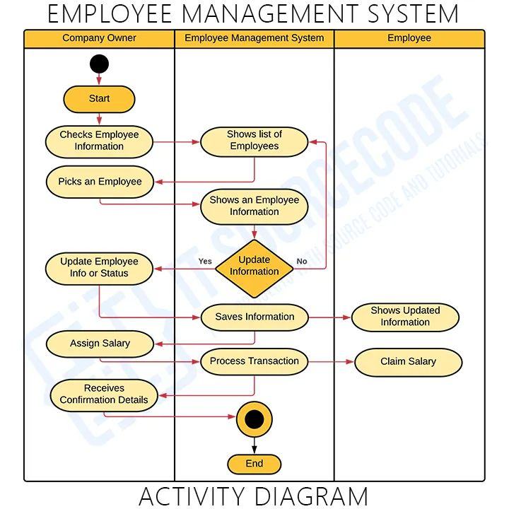
Activity Diagram

Slide 26
Sequence Diagram
A Sequence Diagram in Unified Modeling Language (UML) is a behavioral diagram that models the interaction between objects in a sequential order. It shows how objects communicate with each other over time and emphasizes the sequence of messages exchanged between them. Sequence diagrams are particularly useful for understanding dynamic behavior, such as method calls, event handling, or workflow execution.
Sequence diagrams are widely used during the design phase of software development to visualize how different components of a system interact to achieve specific functionality.

Slide 27
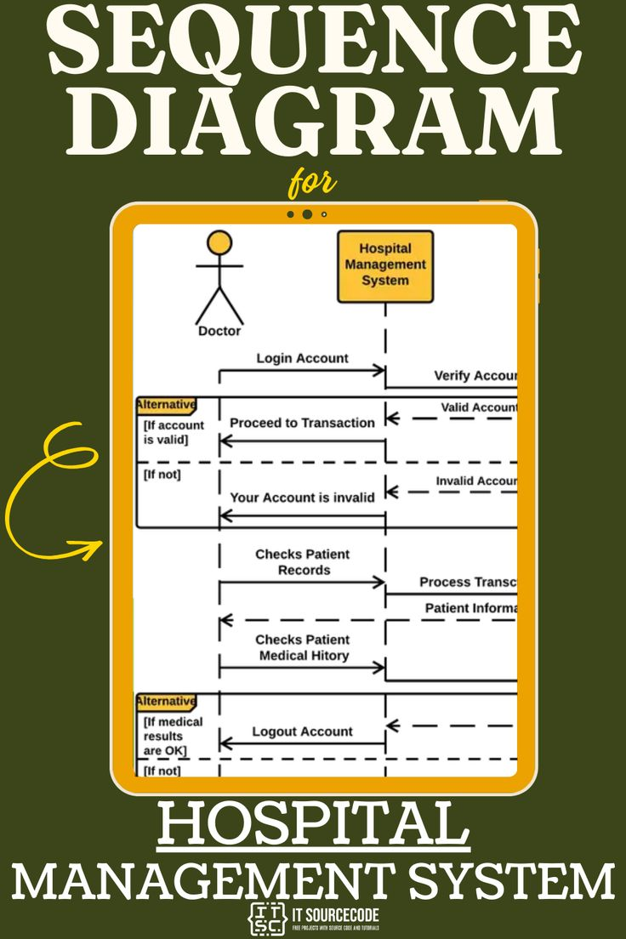
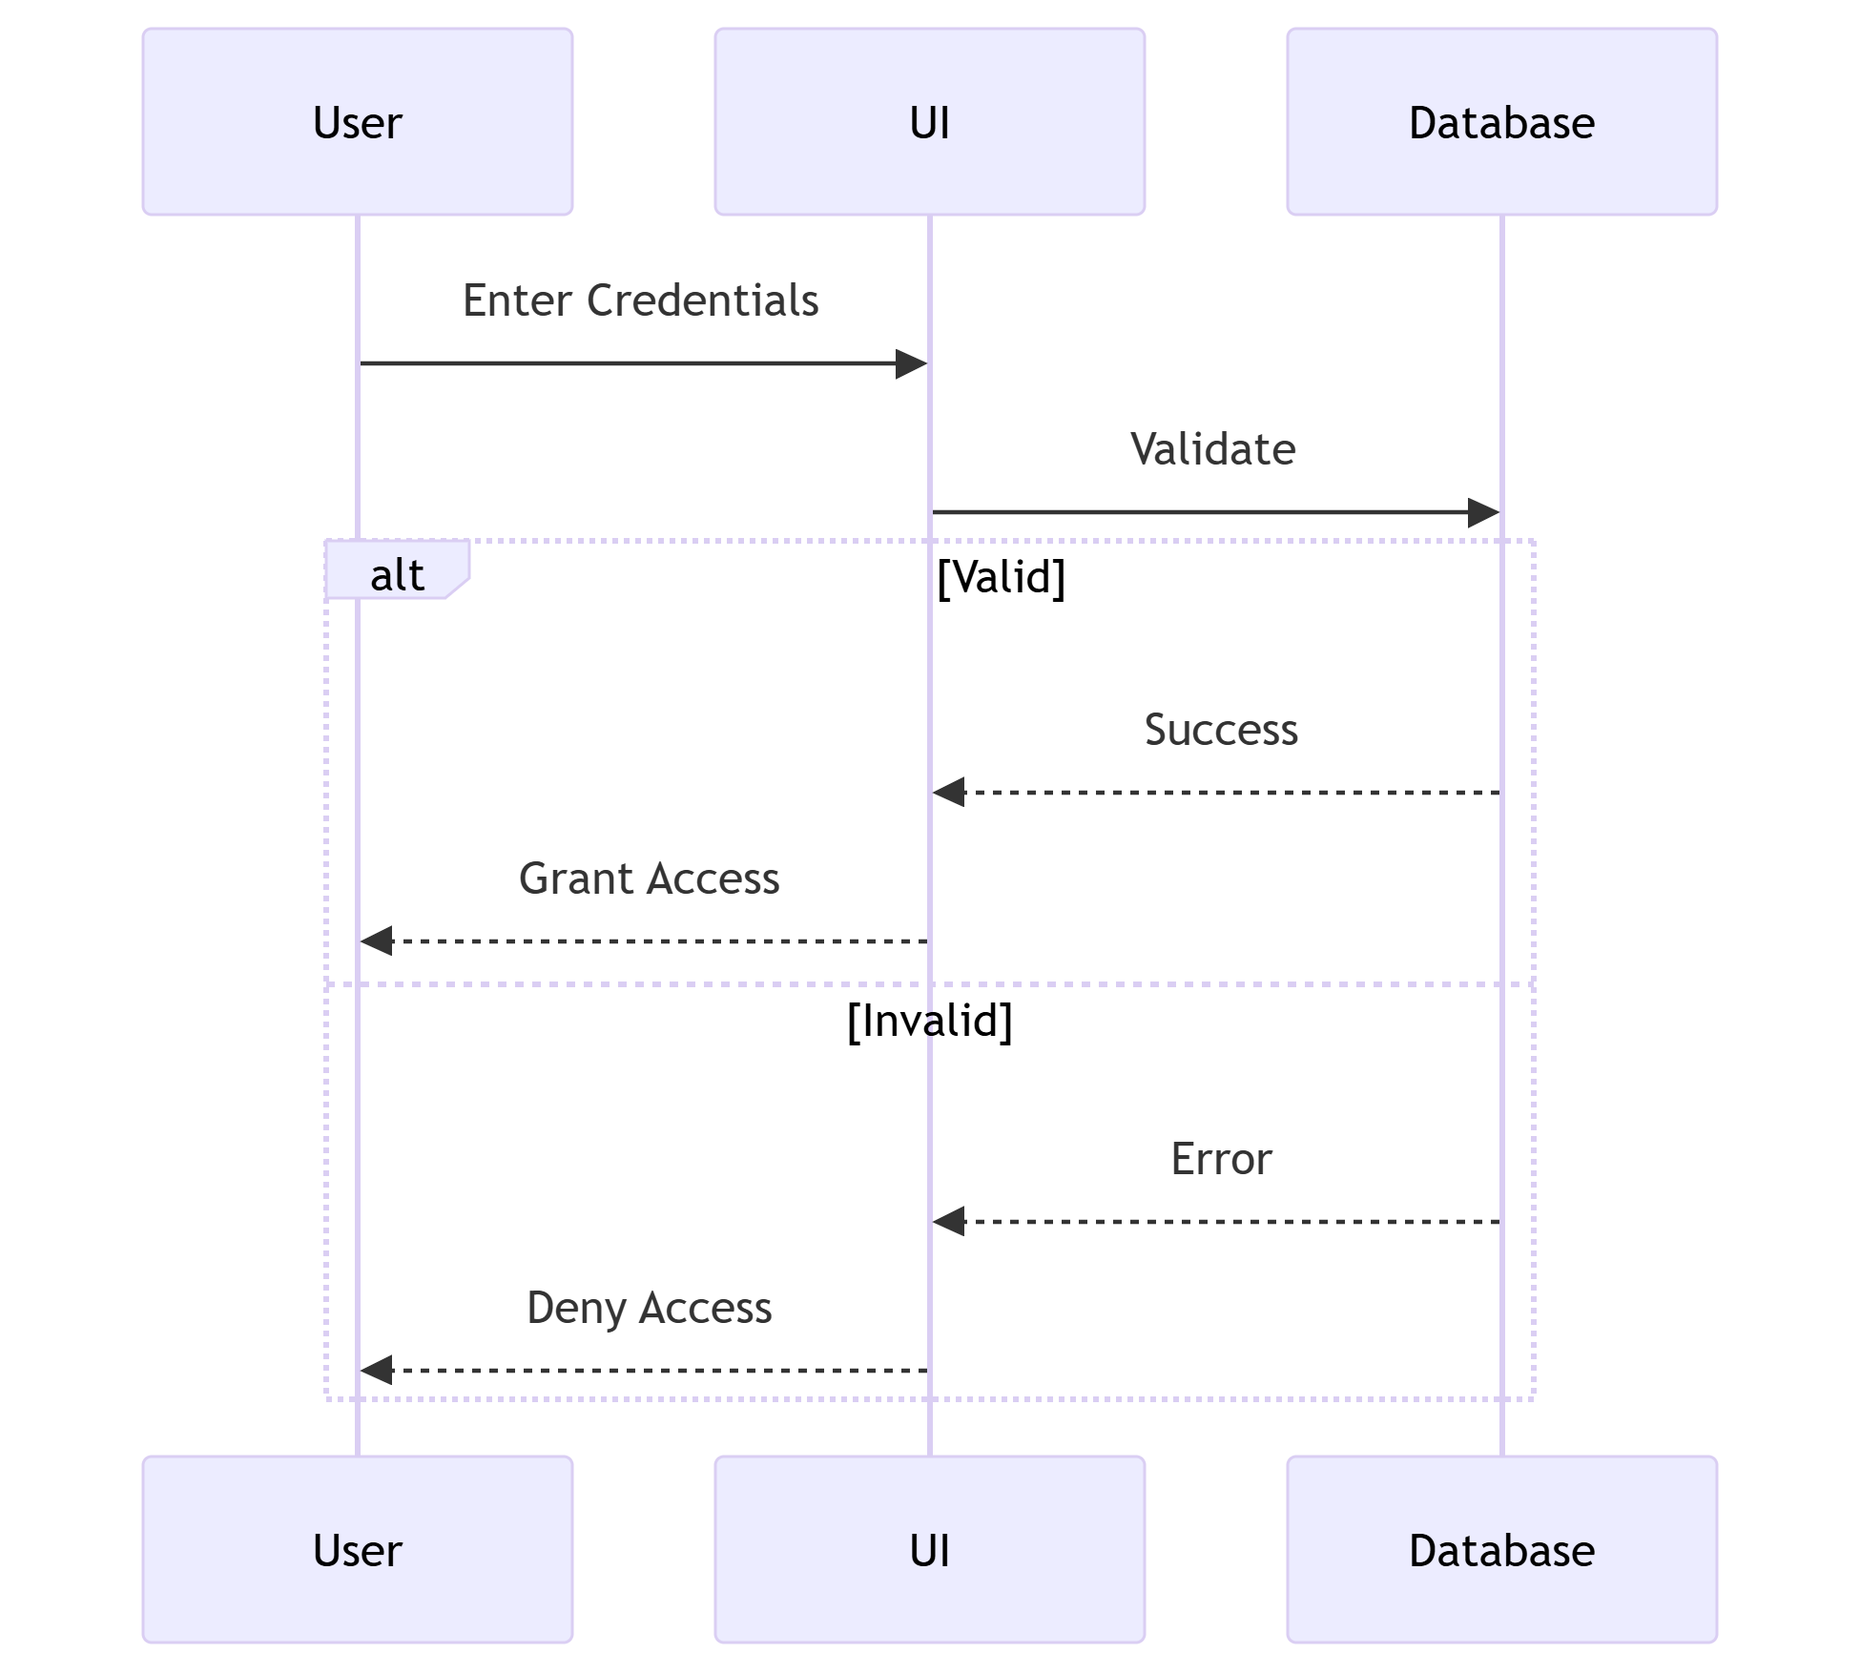
Sequence Diagram cont..
Key Elements:
Lifelines (objects)
Messages (method calls)

Slide 28
The End

